Slide 1
I 💚 Javascript

Slide 2
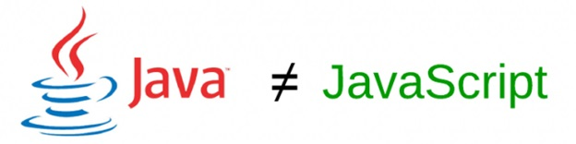

Slide 3
What is Javascript ?

Slide 4
“JS is one of the most popular and widely used programming language.”

Slide 5
Where does JS code run?

Slide 6
Designed to run only in browser! It will also run in Javascript Engine.

Slide 7
Primitive Data Types
“These six types are considered to be primitives. A primitive is not an object and has no methods of its own. All primitives are immutable.”

Slide 8
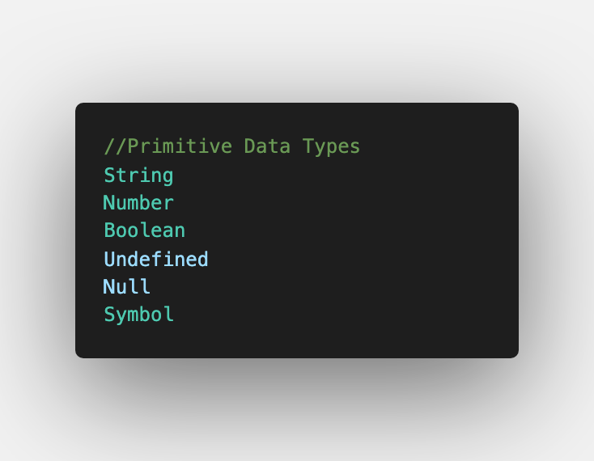

Slide 9
JS is Dynamically typed language🚨.

Slide 10
Reference types

Slide 11
Objects
Arrays
Functions

Slide 12
Objects in JS, it’s building block of modern javascript.
Un ordered collection of related data of primitive or reference types in the form of “key:value” pairs.

Slide 13
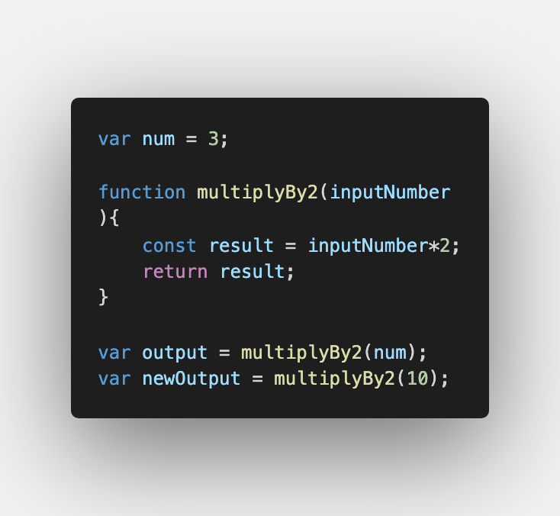
JavaScript principles
When JS code runs:
↘ Goes through the code line-by-line and runs/ ’executes’ each line - known as the thread of execution.
Functions :
Code we save (‘define’) functions & can use (call/invoke/execute/run) later with the function’s name & ( )

Slide 14
Execution context:
Created to run the code of a function - has 2 parts (we’ve already seen them!) - Thread of execution - Memory.

Slide 15
Call stack:
- JavaScript keeps track of what function is currently running (where’s the thread of execution).
- Run a function - add to call stack.
- Finish running the function -JS removes it from call stack
- Whatever is top of the call stack - that’s the function we’re currently running C

